Slide 1
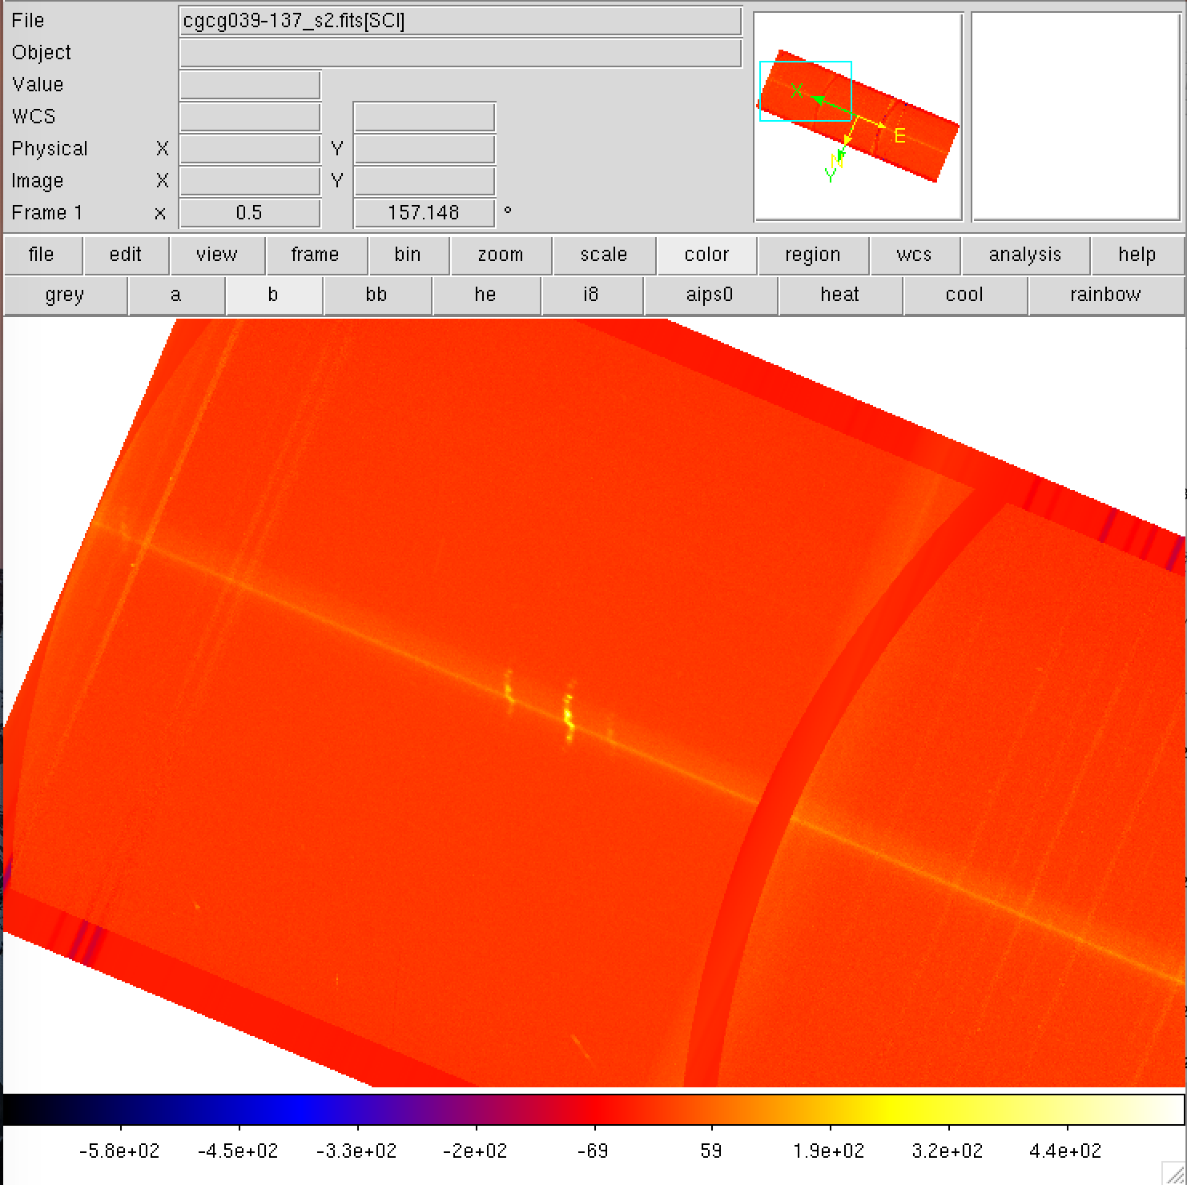
Red side
Blue side
Increasing wavelength
Notes:
Corrected (11/2017)

Slide 2
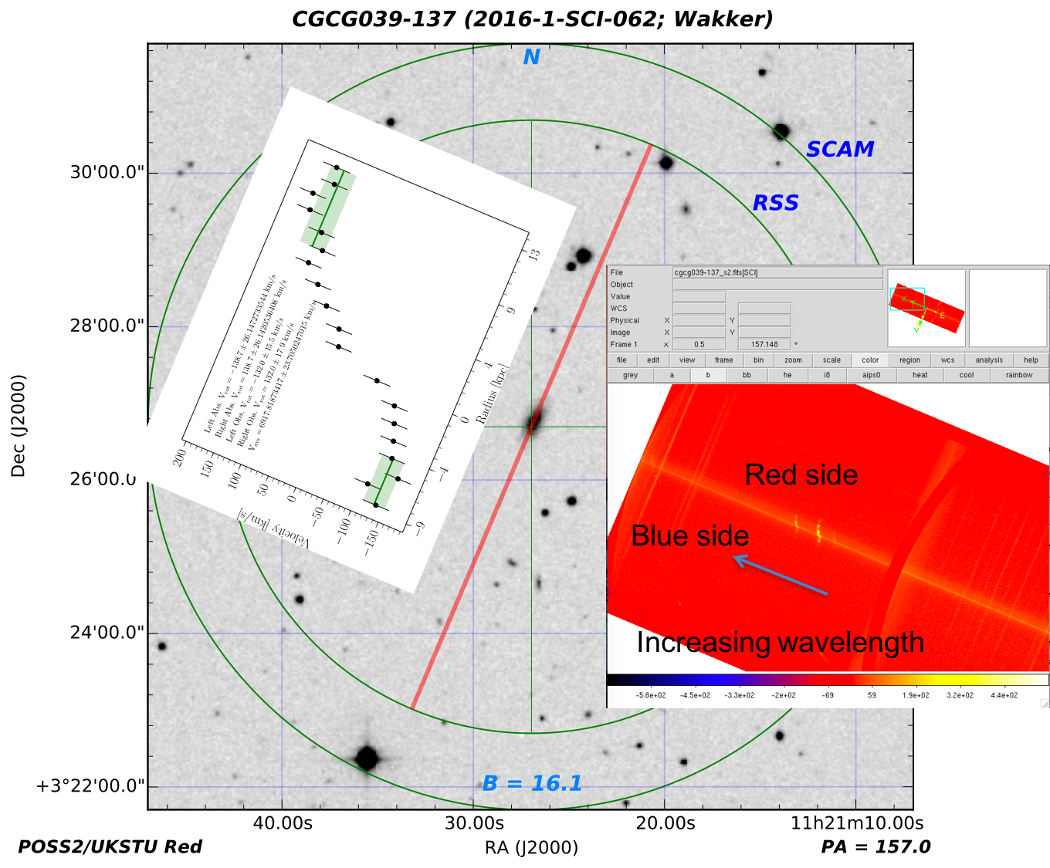
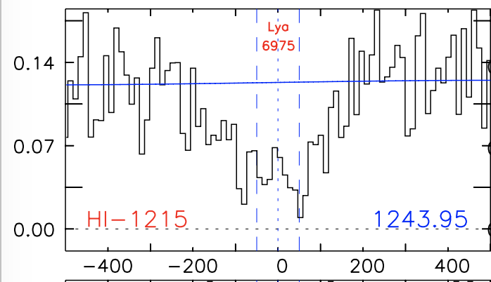
+132 km/s
-132 km/s
Nothing
dv = -73km/s
Notes:
Corrected (12/062017)

Slide 3
impact
galaxy
sightline
Notes:
Corrected (11/2017)

Slide 4
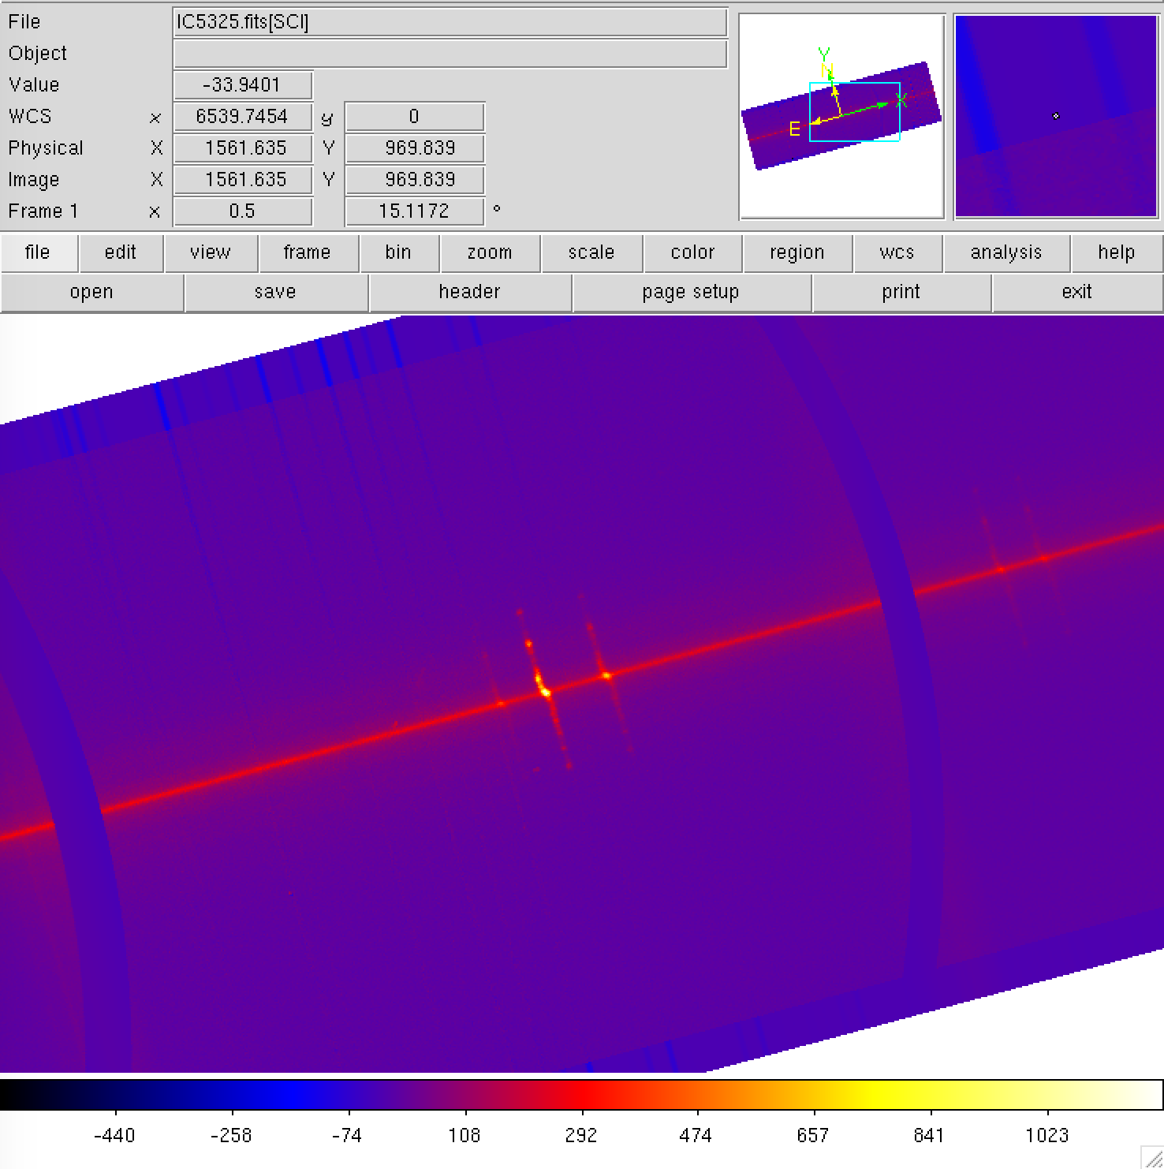
15 deg rotated
Blue side
Red side
Increasing wavelength
Notes:
Correct (11/20/17)

Slide 5
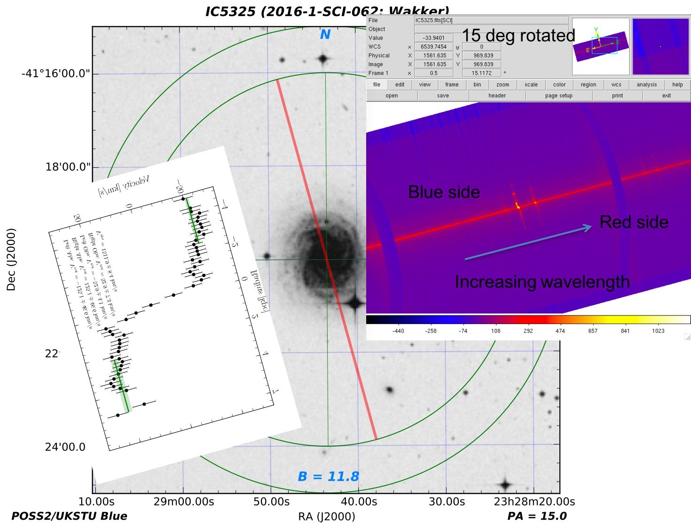
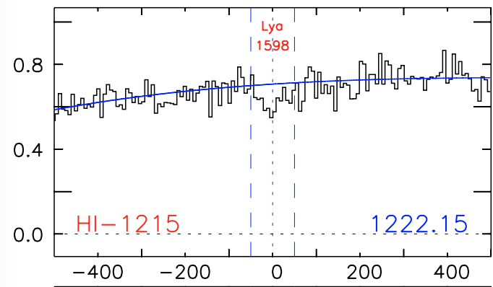
dv = +95 km/s
-53 km/s
+53 km/s
Notes:
Correct (12/06/17)

Slide 6
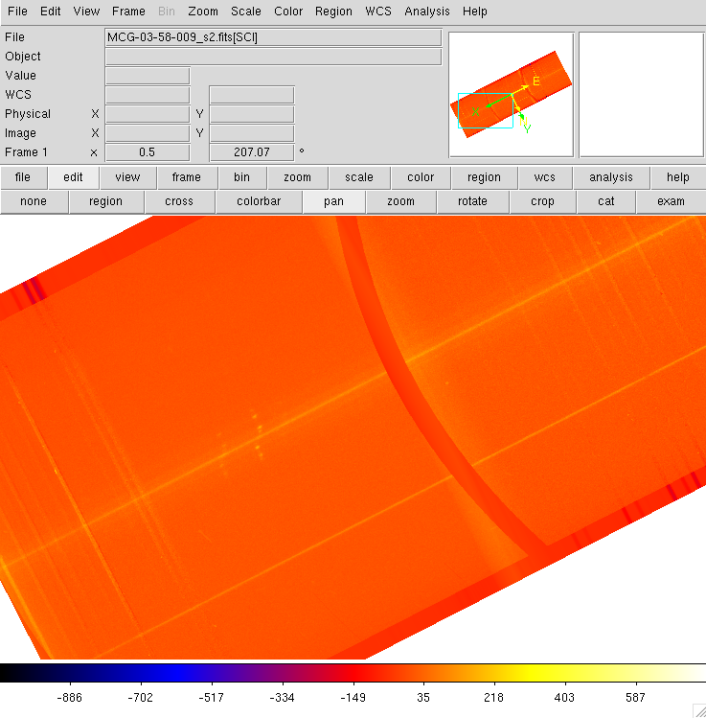
blue
red
Increasing wavelength
Notes:
Correct (11/20/17)

Slide 7
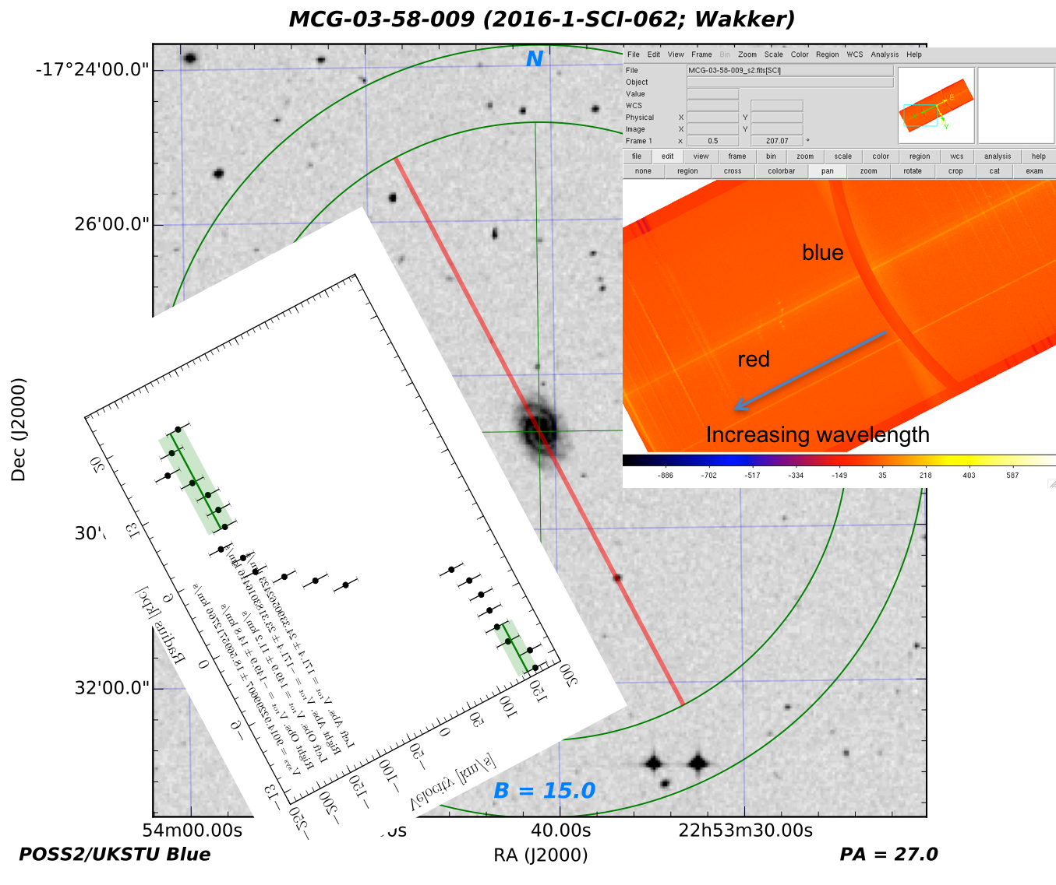
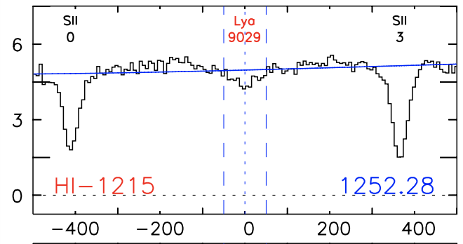
-150 km/s
+150 km/s
dv = -1 km/s
Notes:
Correct (12/6/17)

Slide 8
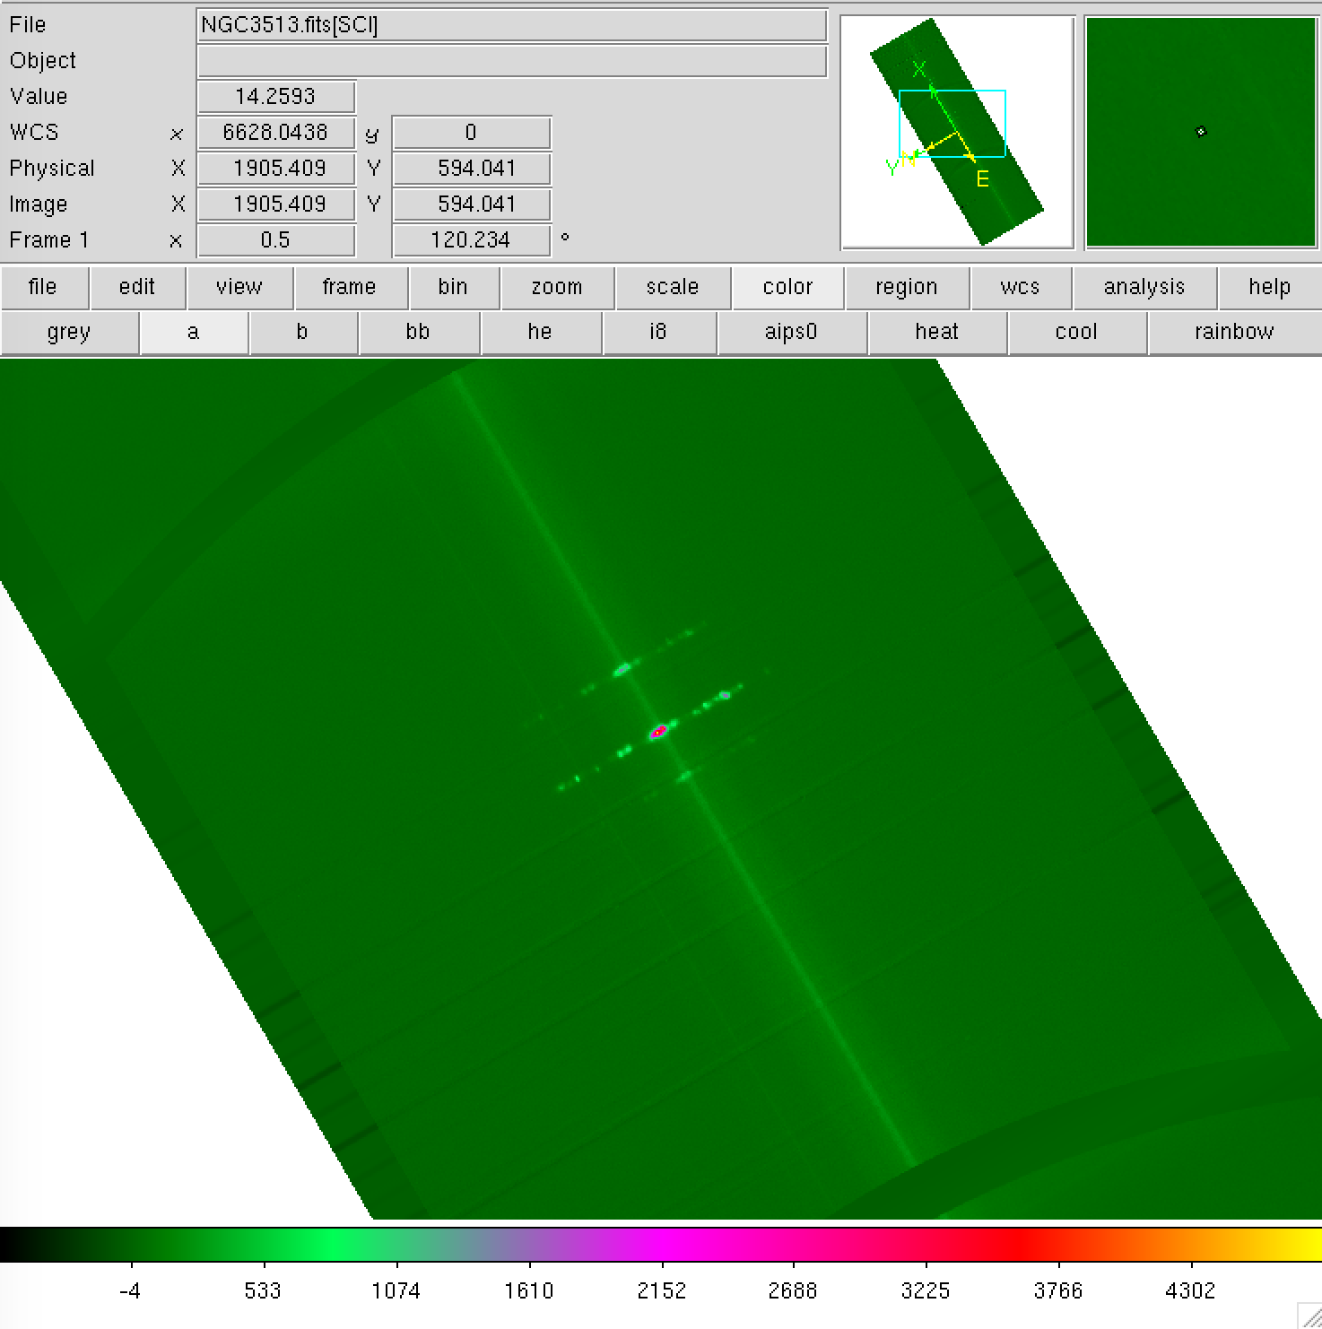
Increasing wavelength
Blue side
Red side
Notes:
Correct (11/20/17)

Slide 9
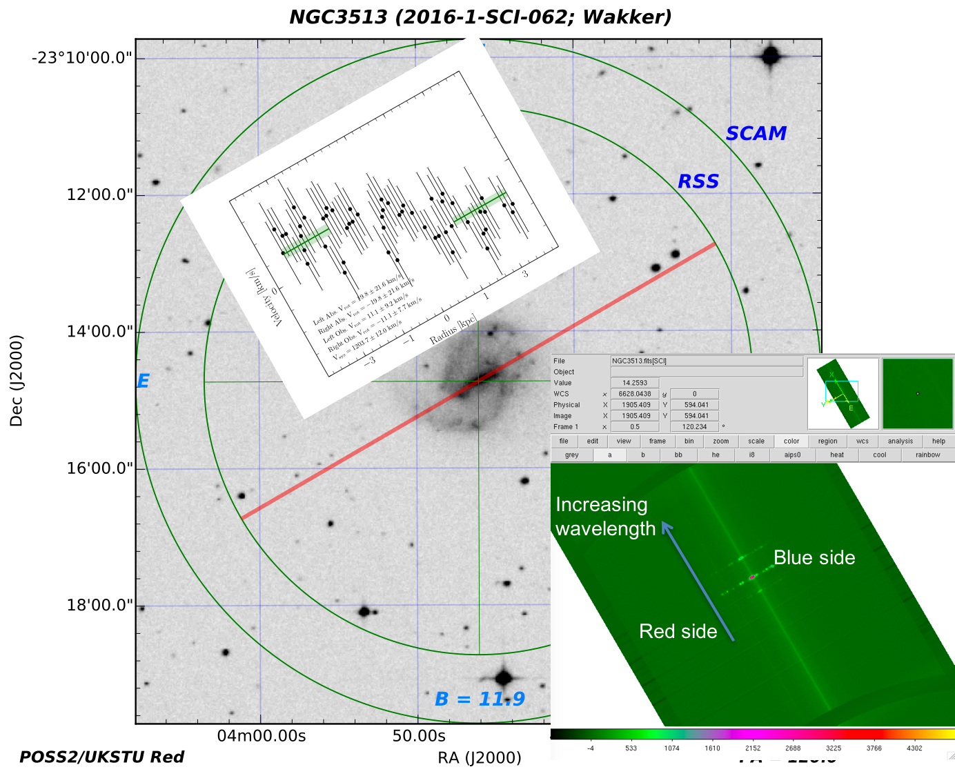
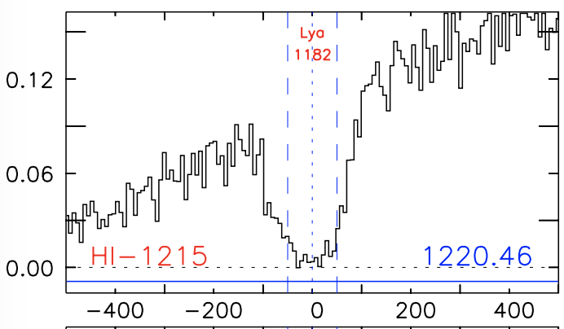
-11 km/s
+11 km/s
dv = -12 km/s
Notes:
Correct (12/06/17)

Slide 10
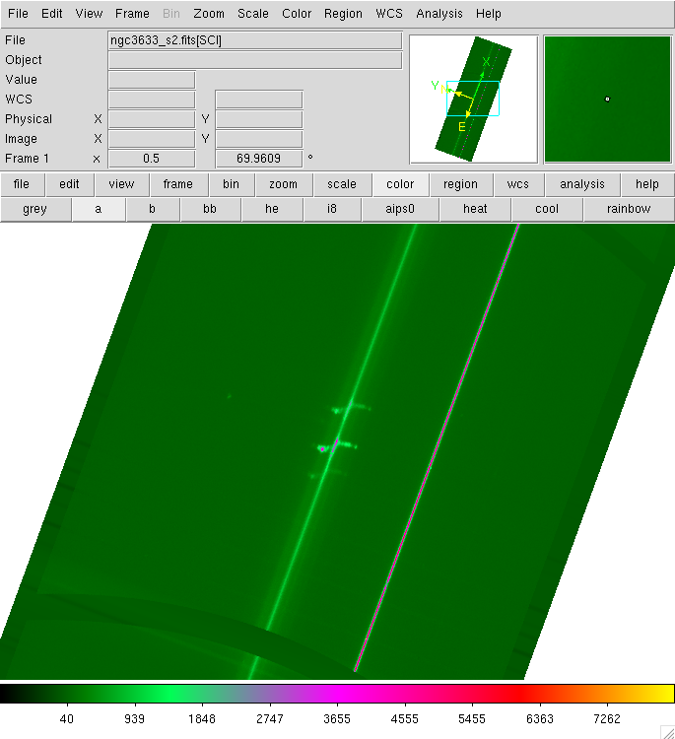
Increasing wavelength
Red side
Blue side
Notes:
This should be correct (11/20/17)

Slide 11
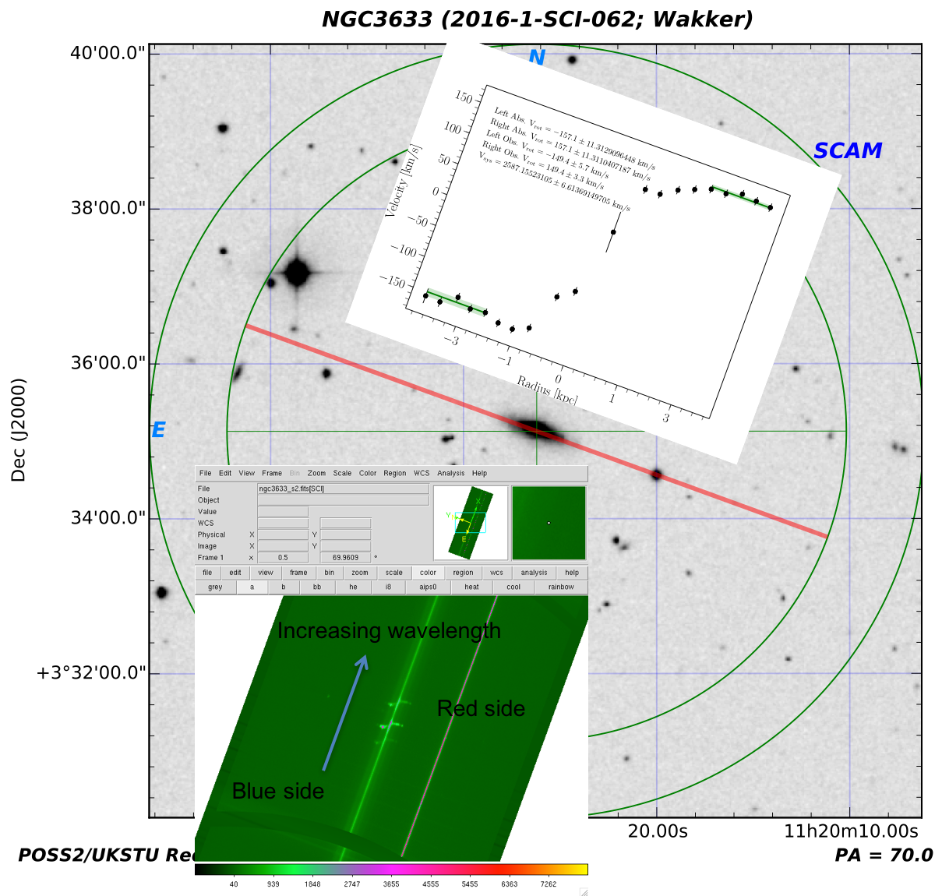
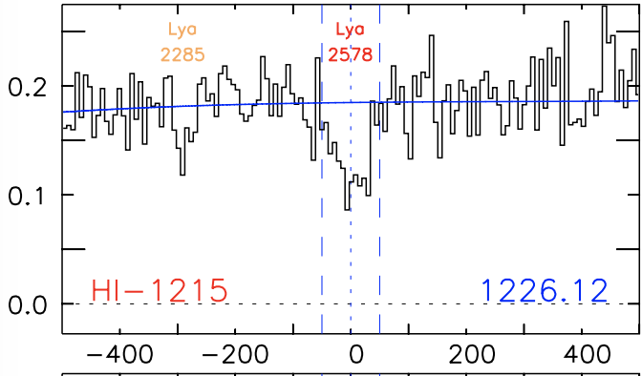
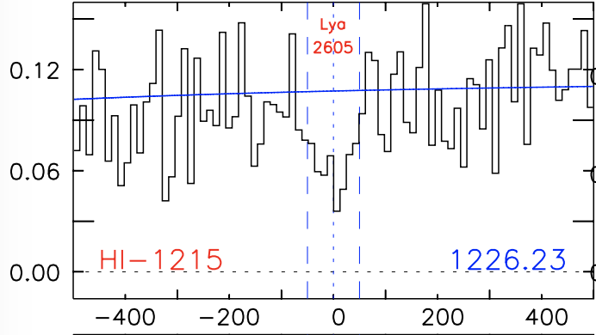
dv = -22 km/s
dv = -315 kms/
-149 km/s
+149 km/s
dv = +5 km/s
Nothing
Notes:
This should be correct (12/06/17)

Slide 12
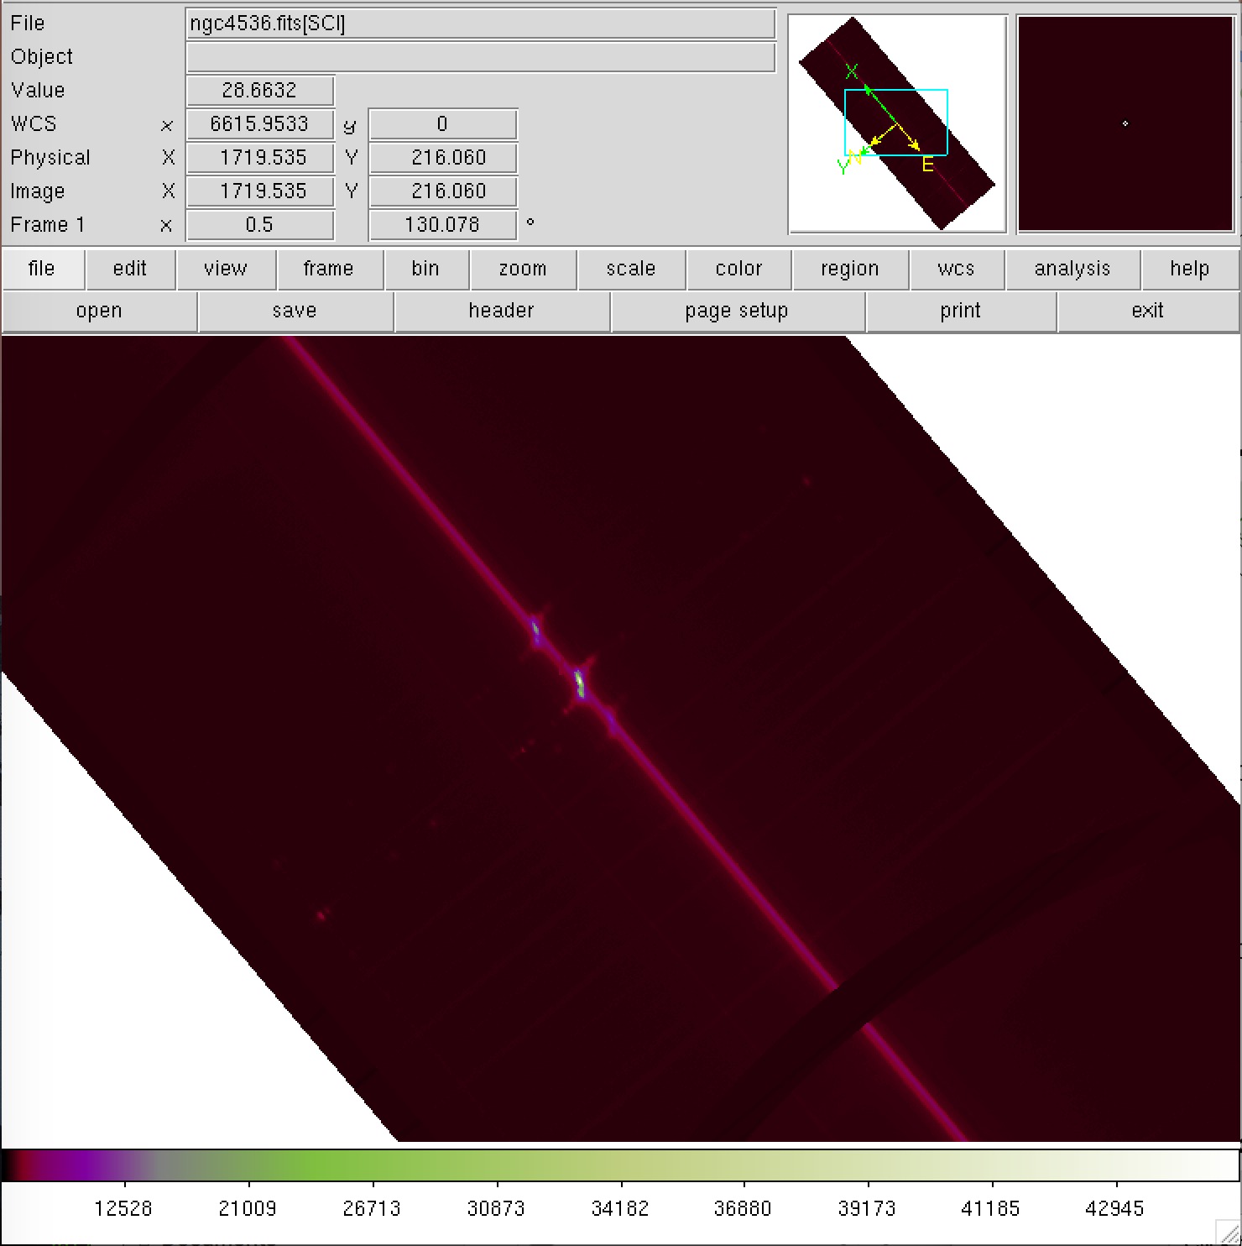
Increasing wavelength
Red side
Blue side
Notes:
Correct (11/20/17)

Slide 13
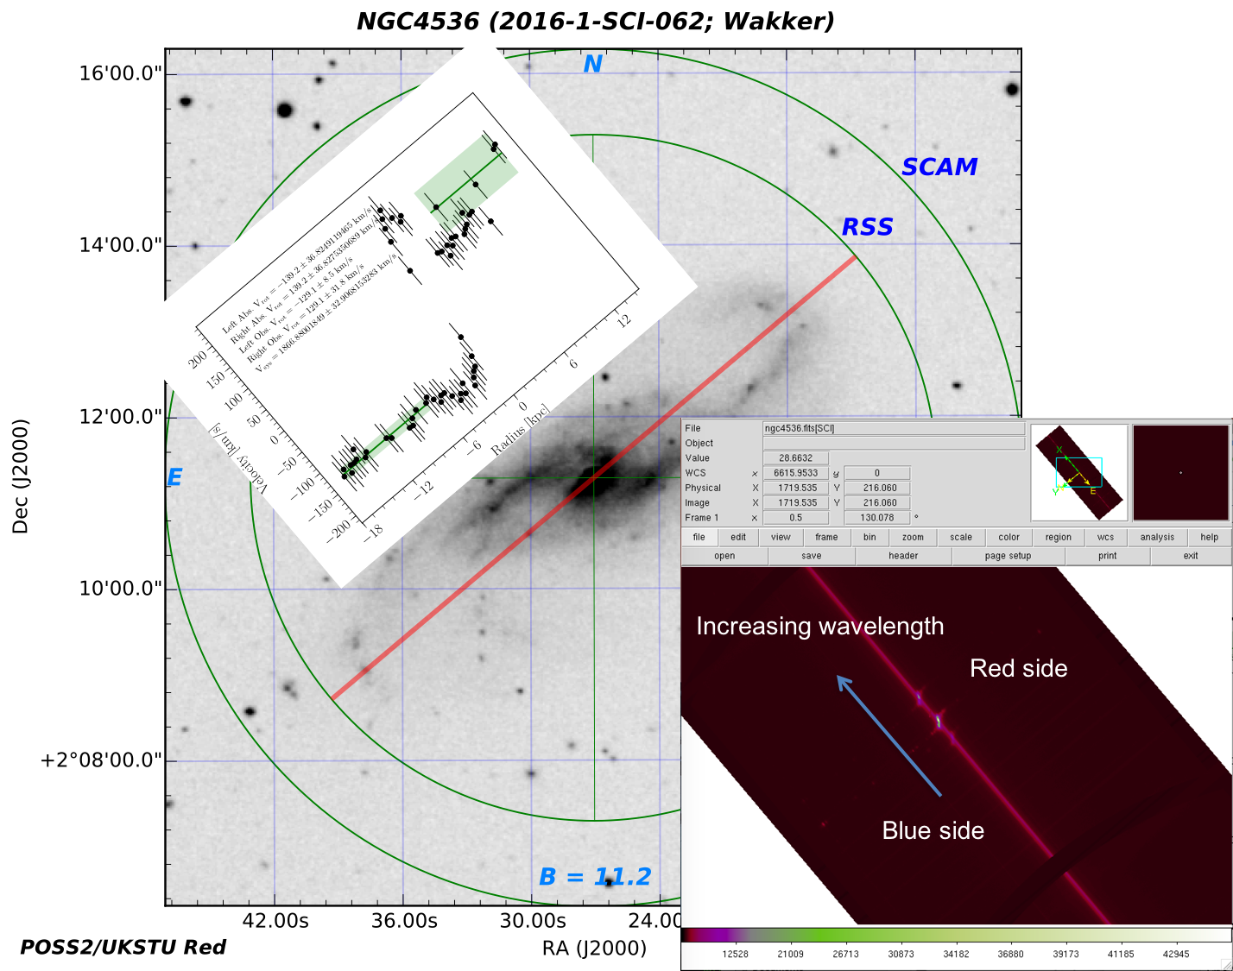
Notes:
Correct (11/20/17)

Slide 14
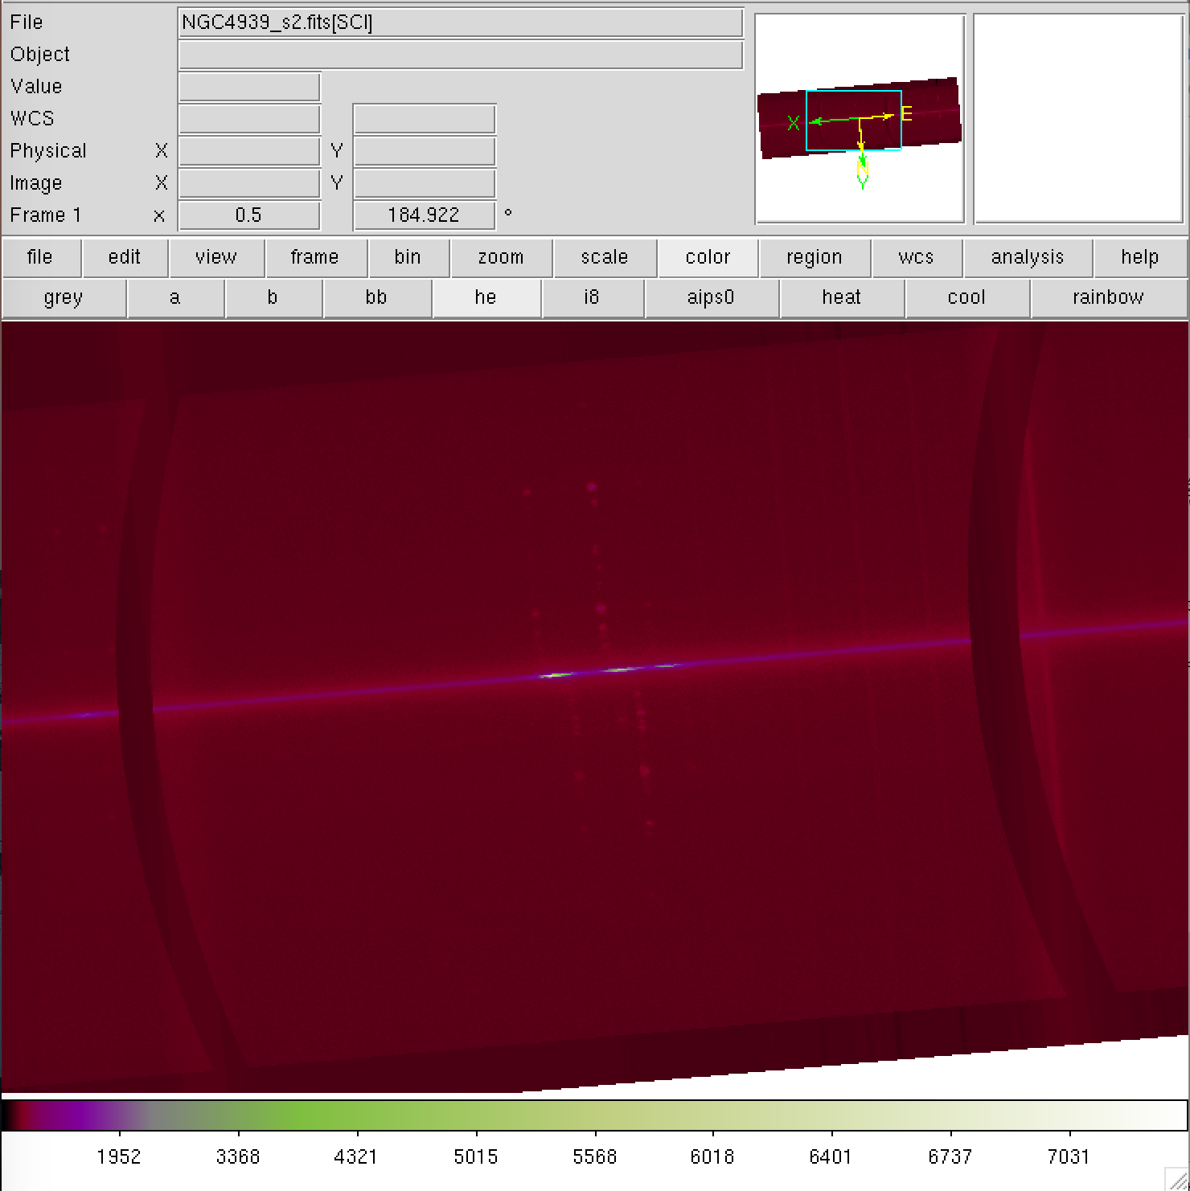
red
blue
Increasing wavelength
Notes:
Probably correct (11/20/17)

Slide 15
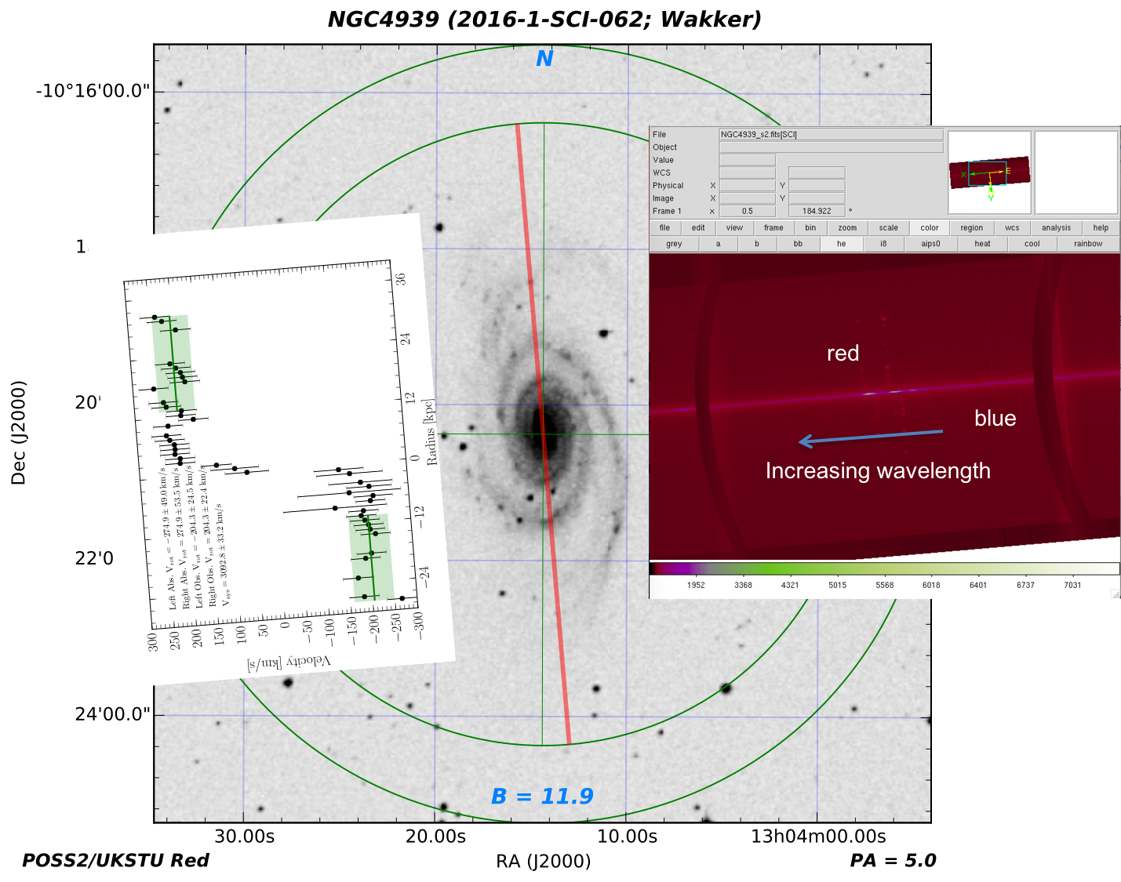
+204 km/s
-204 km/s
Notes:
Probably correct (11/20/17)

Slide 16
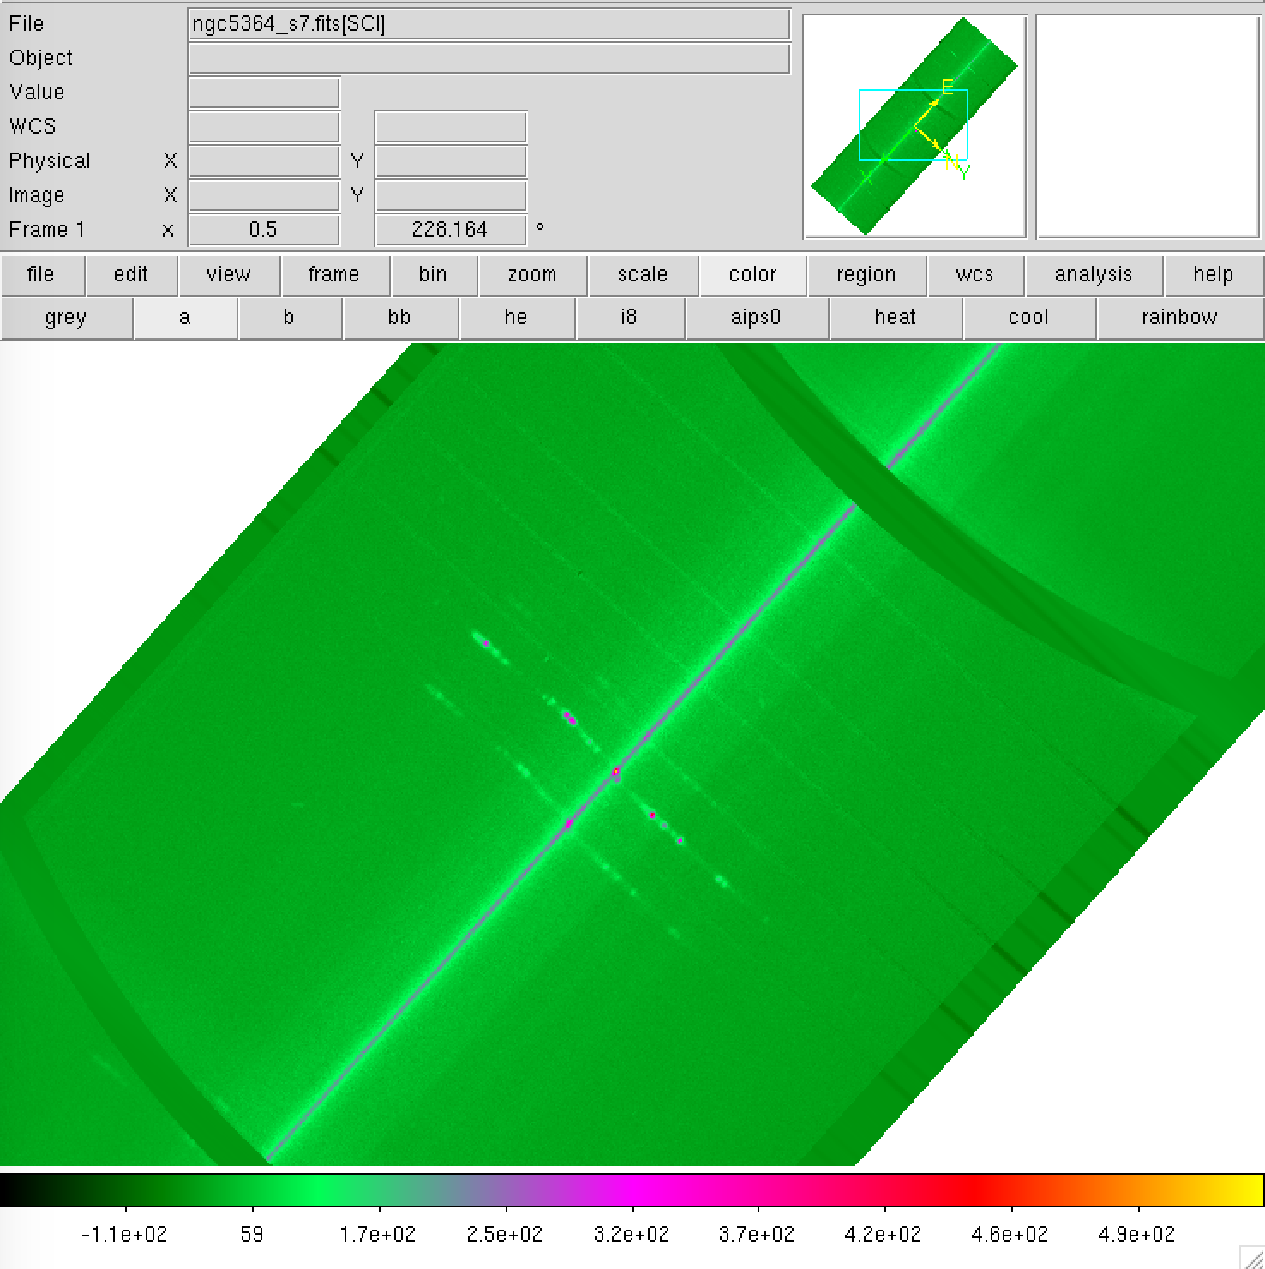
Blue side
Red side
Increasing wavelength

Slide 17
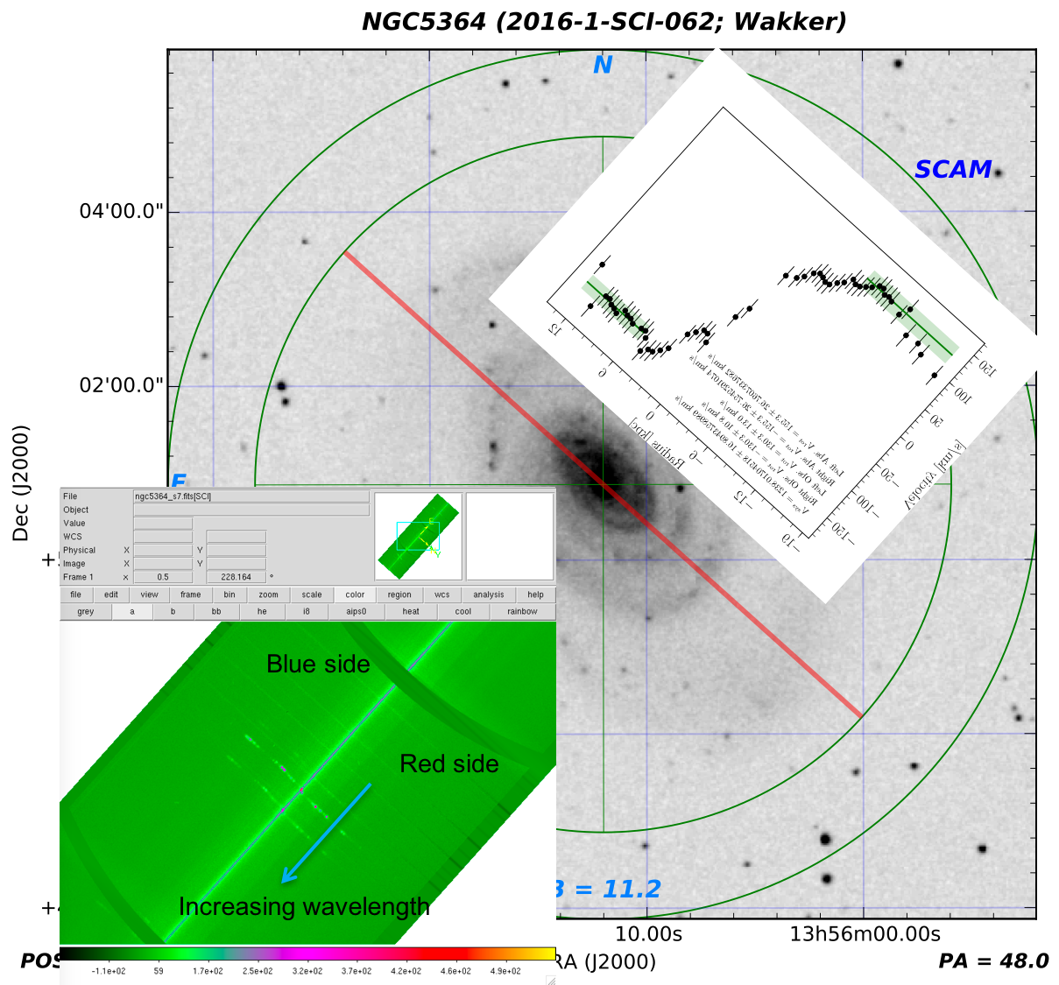

Slide 18
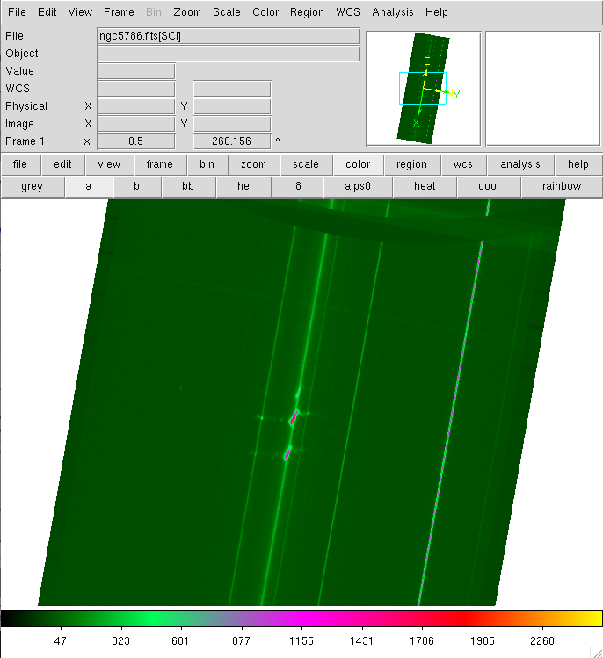
Red side
Blue side
Increasing wavelength
Notes:
This should be correct (11/20/17)

Slide 19
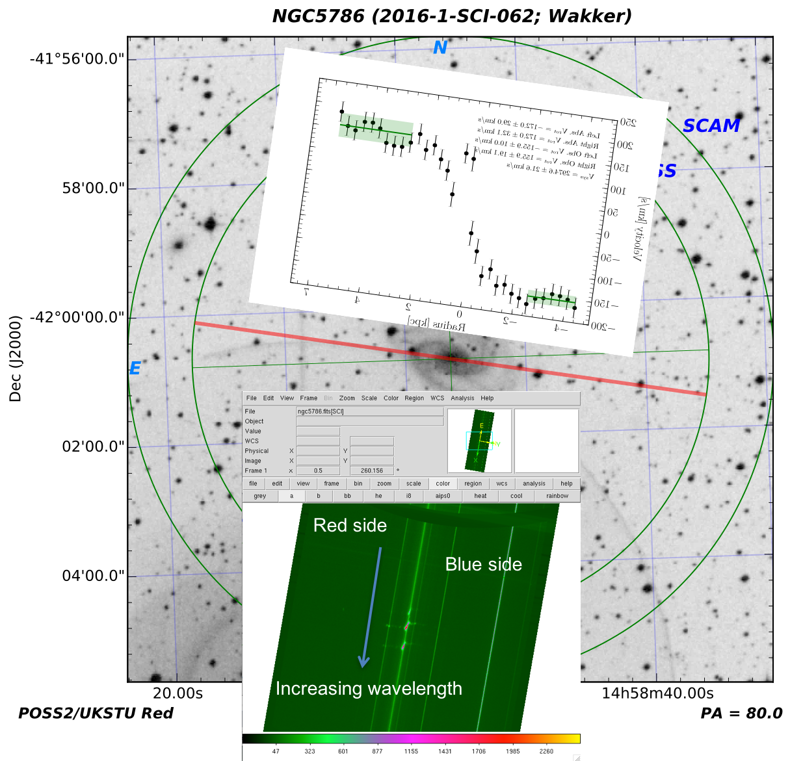
Notes:
This should be correct (11/20/17)

Slide 20
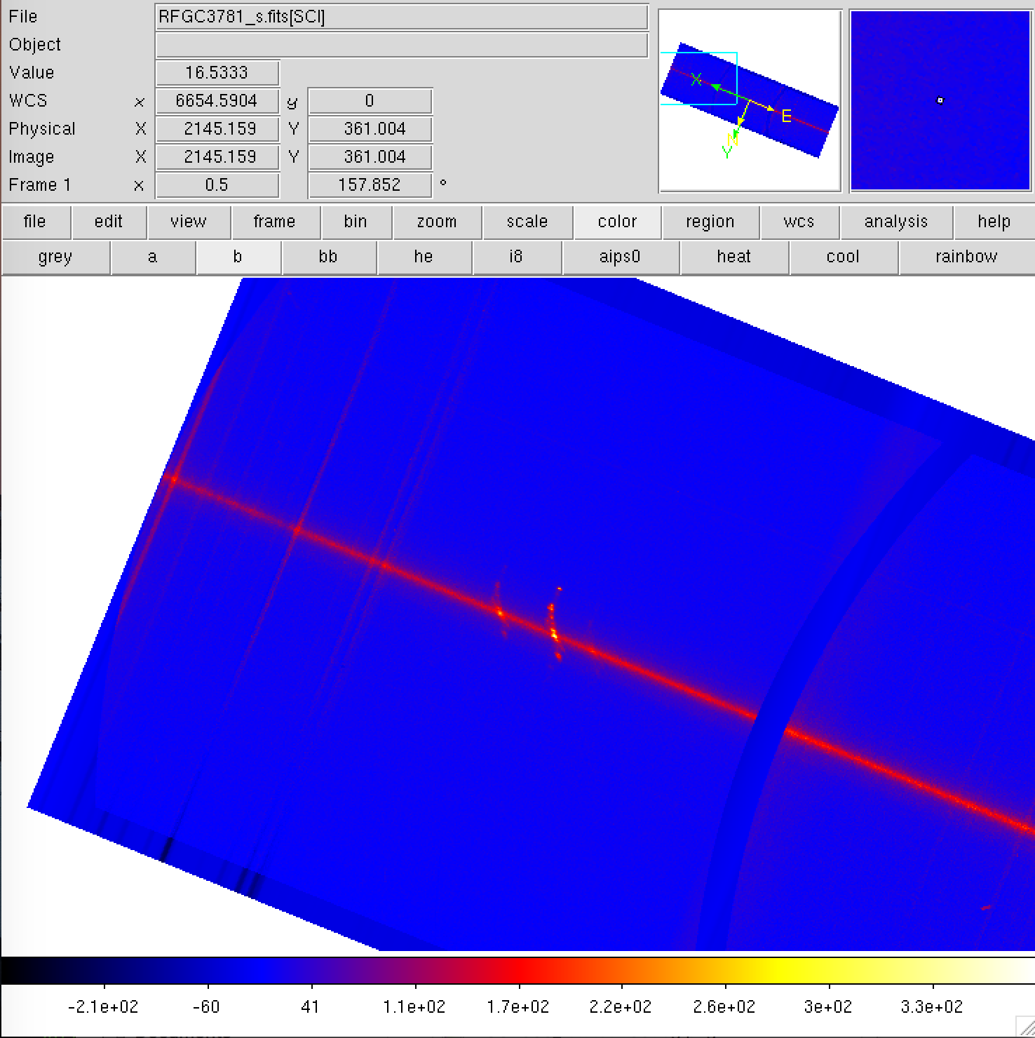
Red side
Blue side
Increasing wavelength
Notes:
Correct (11/20/17)

Slide 21
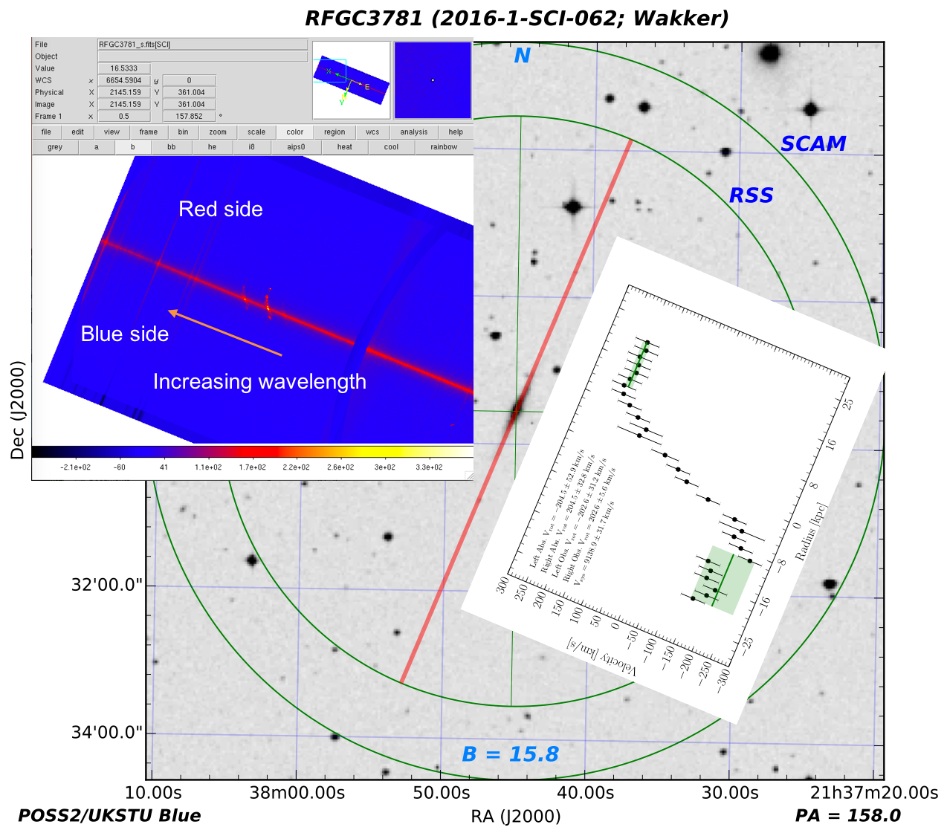
Notes:
Correct (11/20/17)

Slide 22
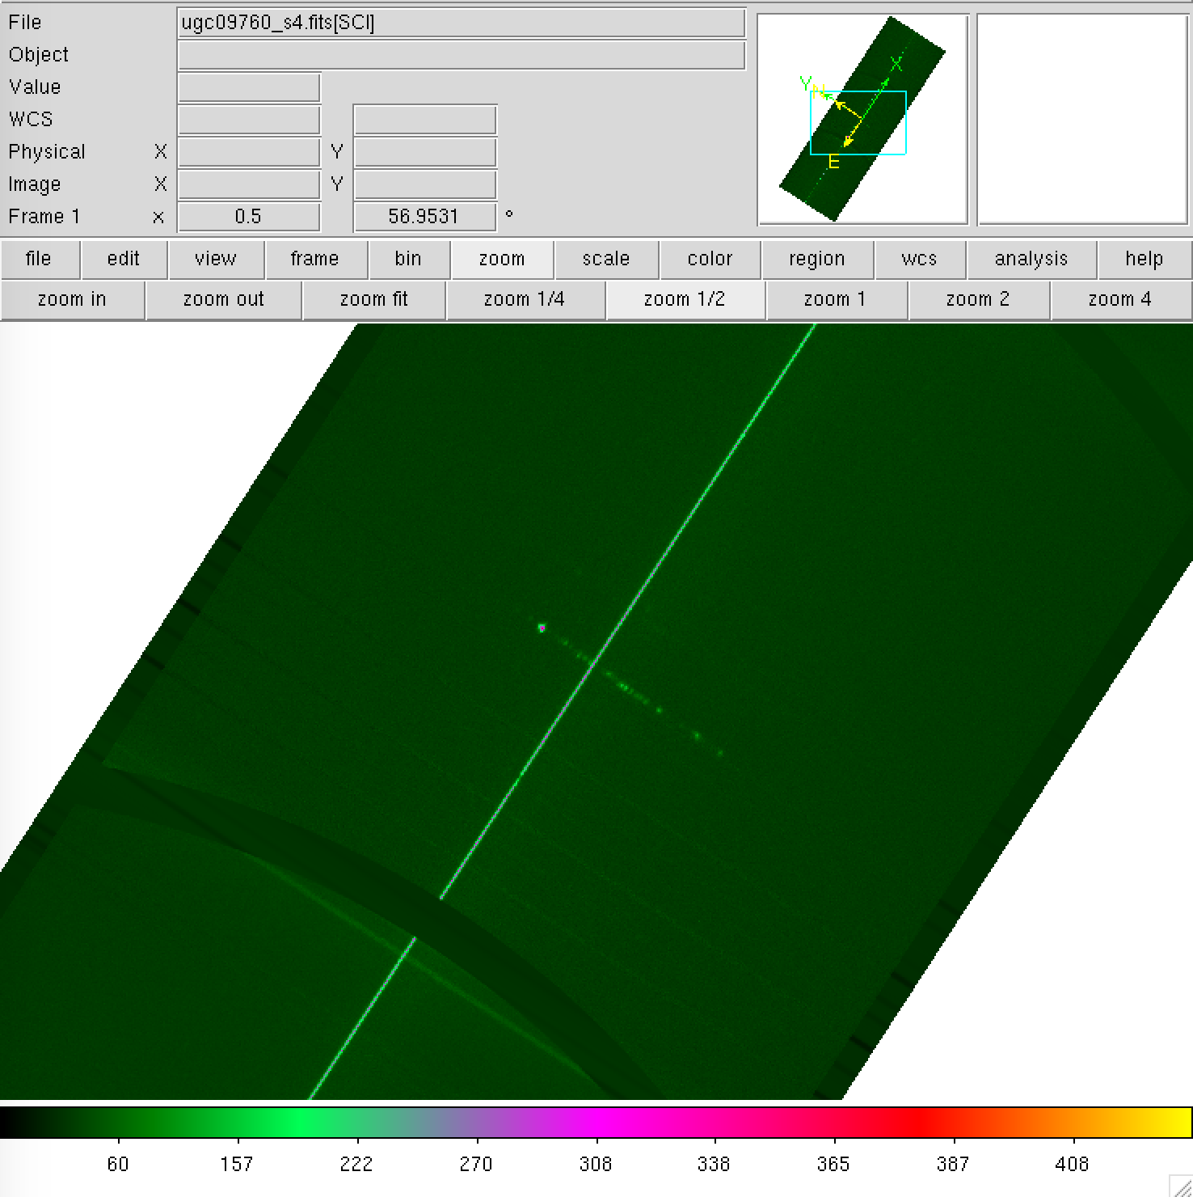
Increasing wavelength
Red side
Blue side
Notes:
Correct (11/20/17)

Slide 23
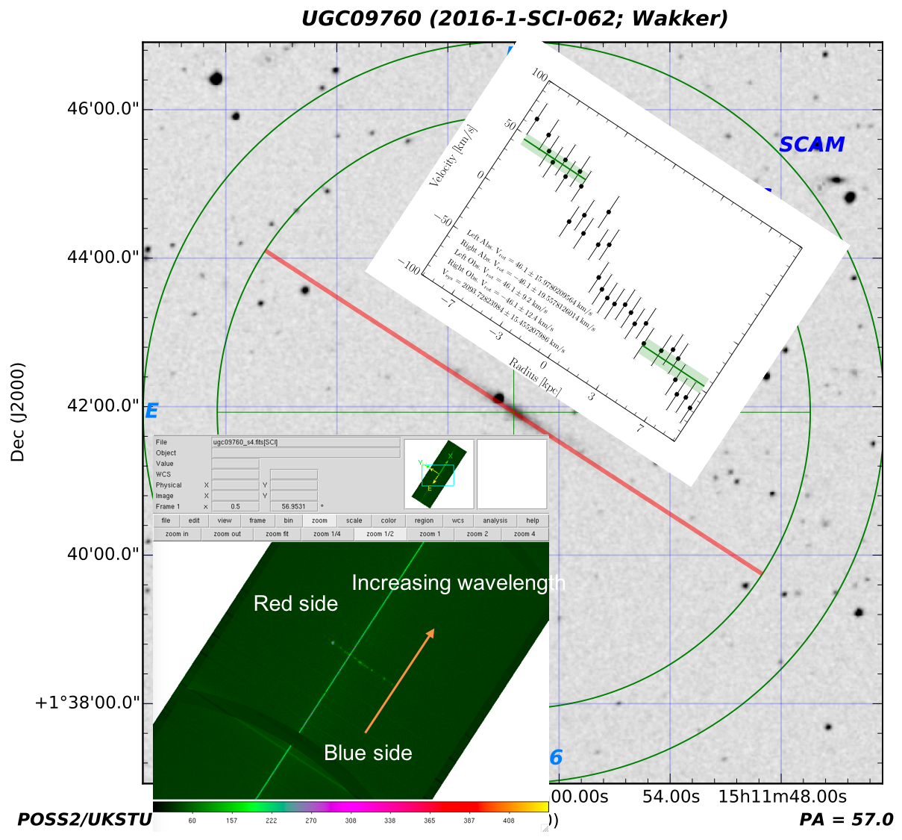
Notes:
Correct (11/20/17)

Slide 24
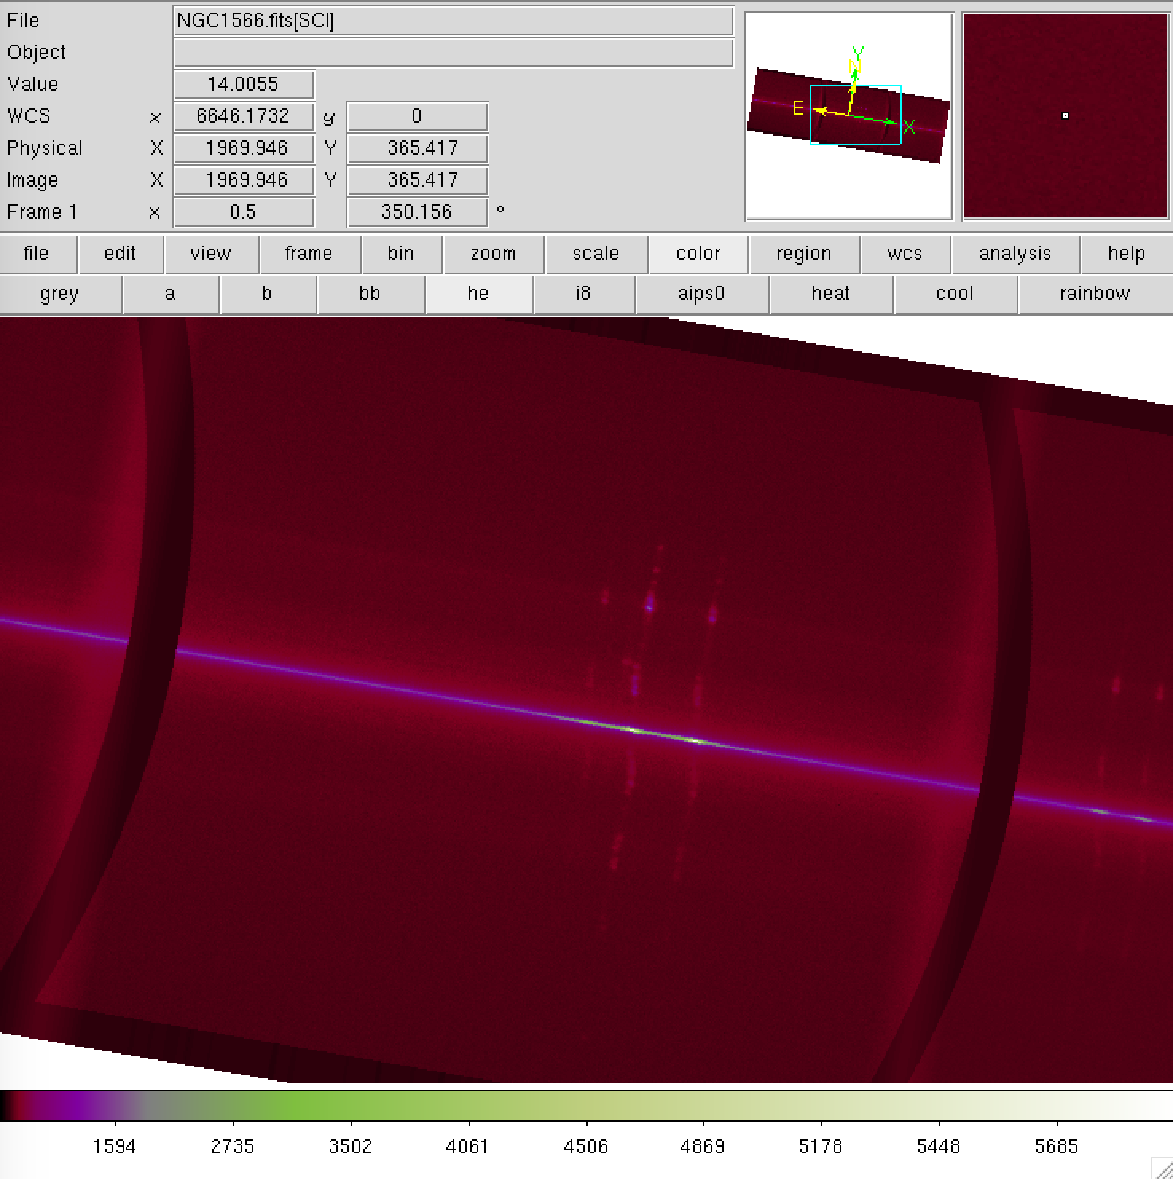
Increasing wavelength
Blue side
Red side
Notes:
Correct (11/20/17)

Slide 25
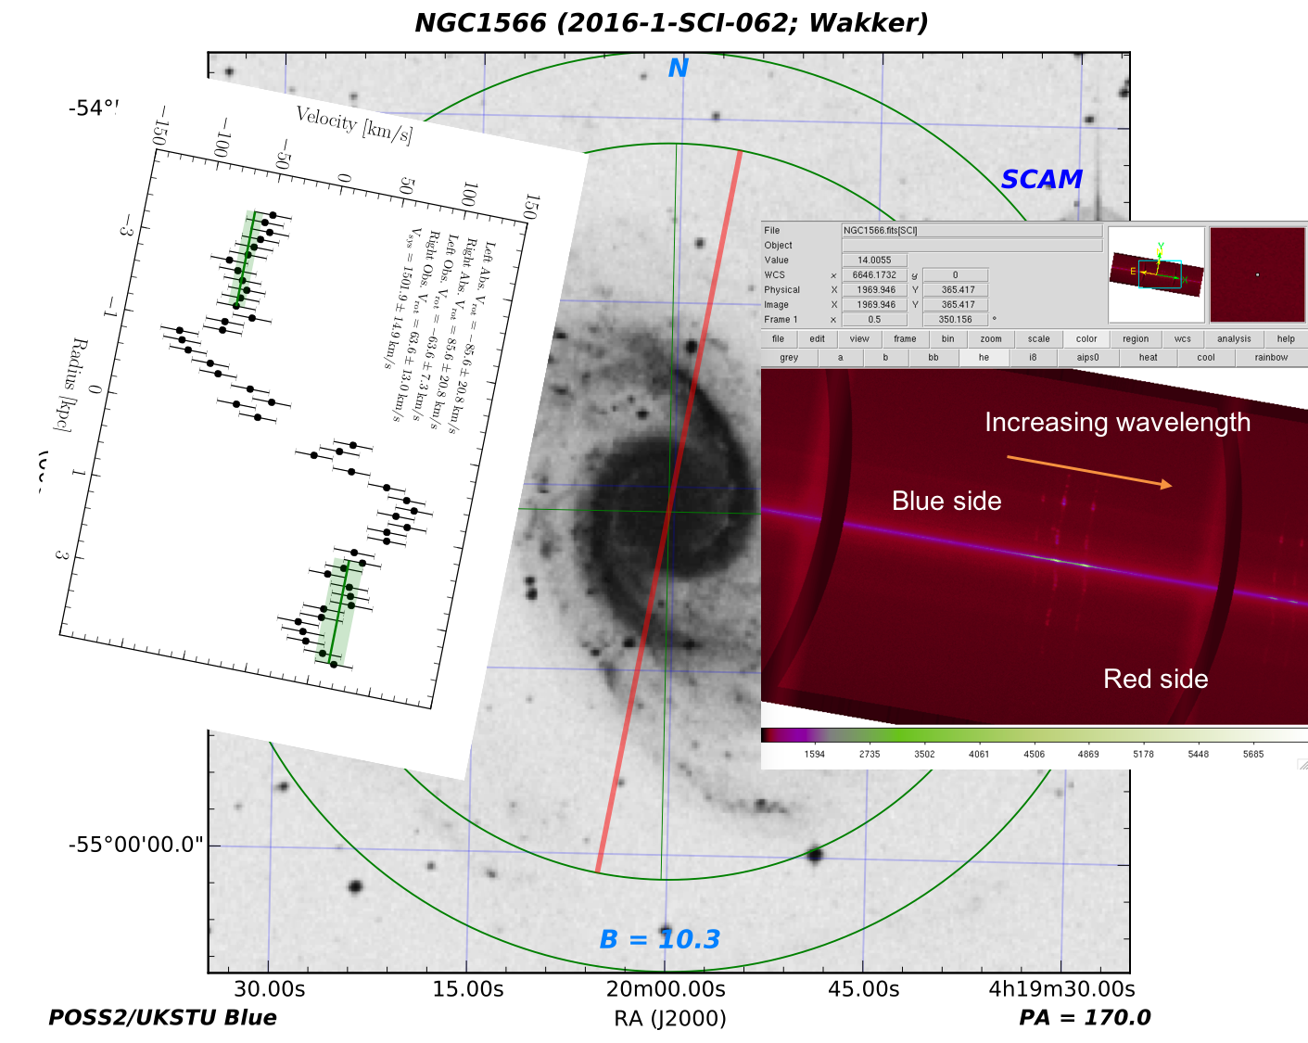
Notes:
Correct (11/20/17)

